Slide 1
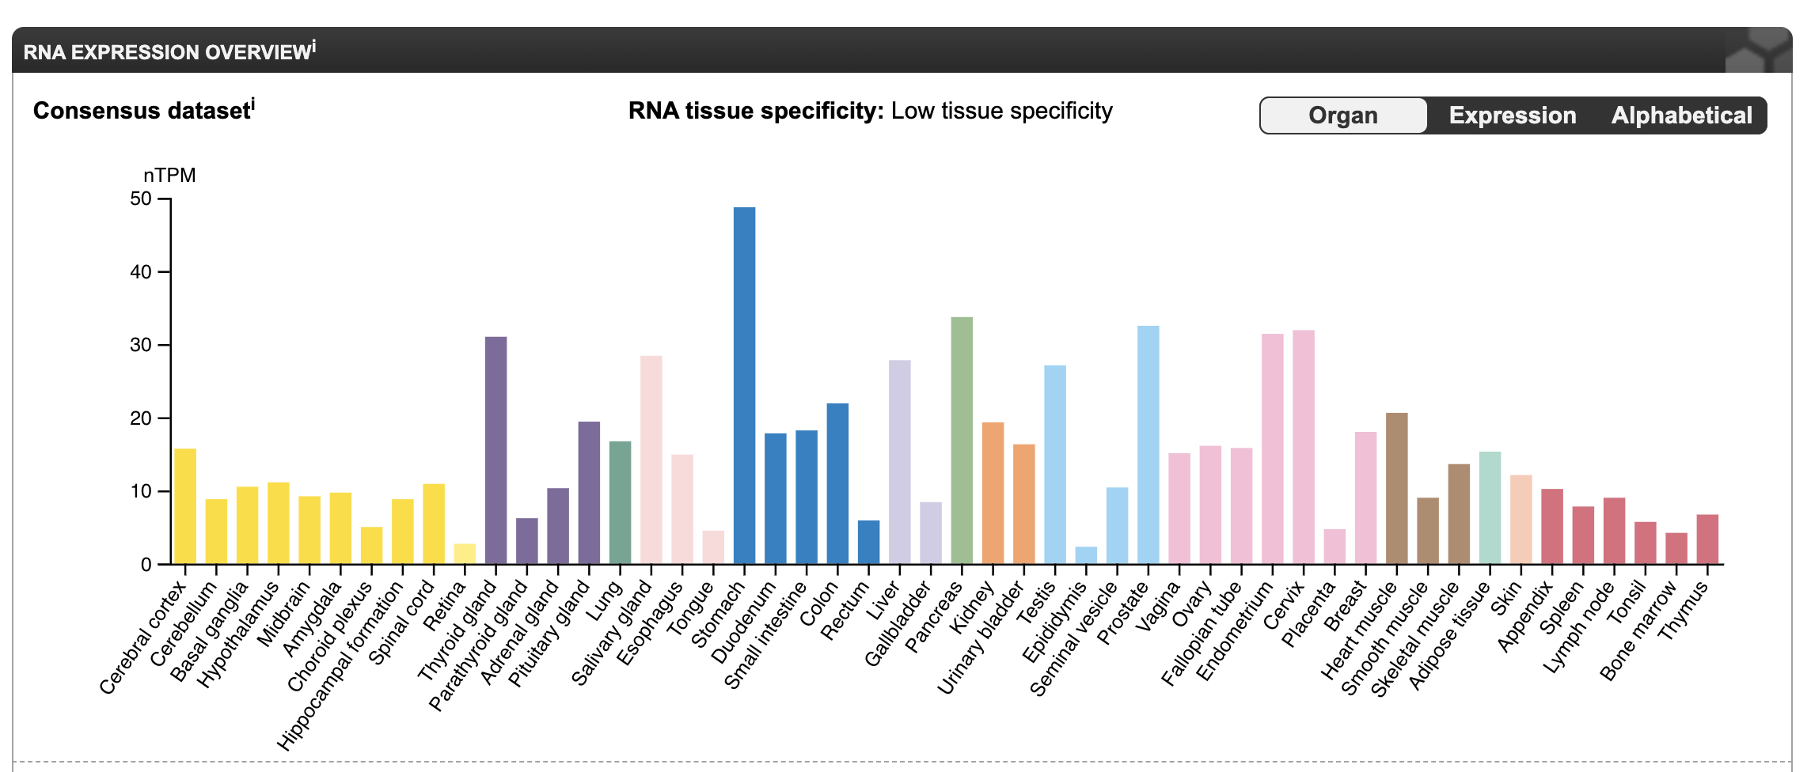
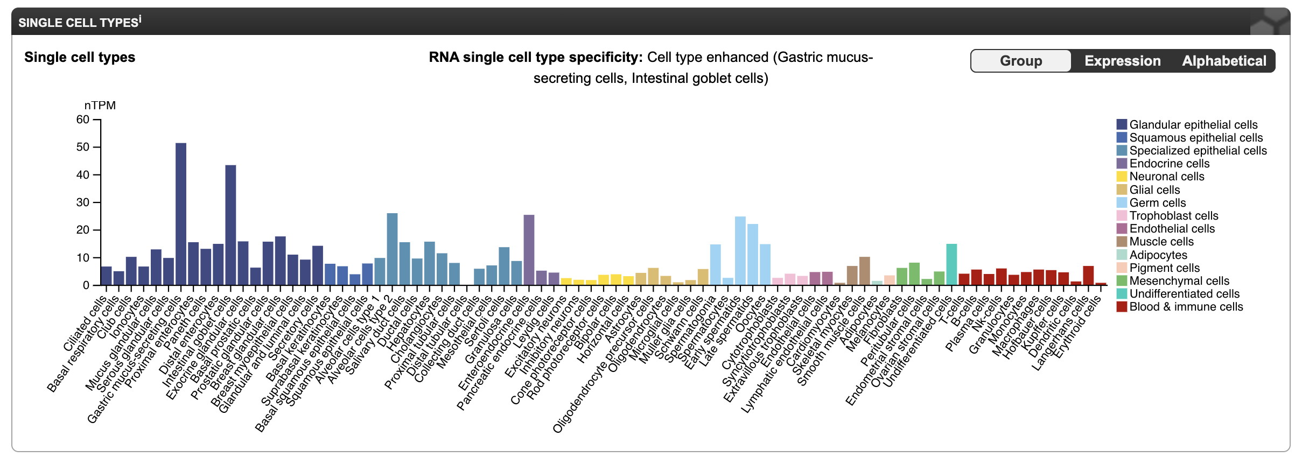
(a)
(b)
Supp Fig 1: Expression of FOXP4 in (a) different tissues and (b) Cells. Data obtained from https://www.proteinatlas.org/

Slide 2
Supp Fig 2: Heatmap showing the Fst value across 26 population of 1000 genome. Complete heatmap is in Supp Fig 6.

Slide 3
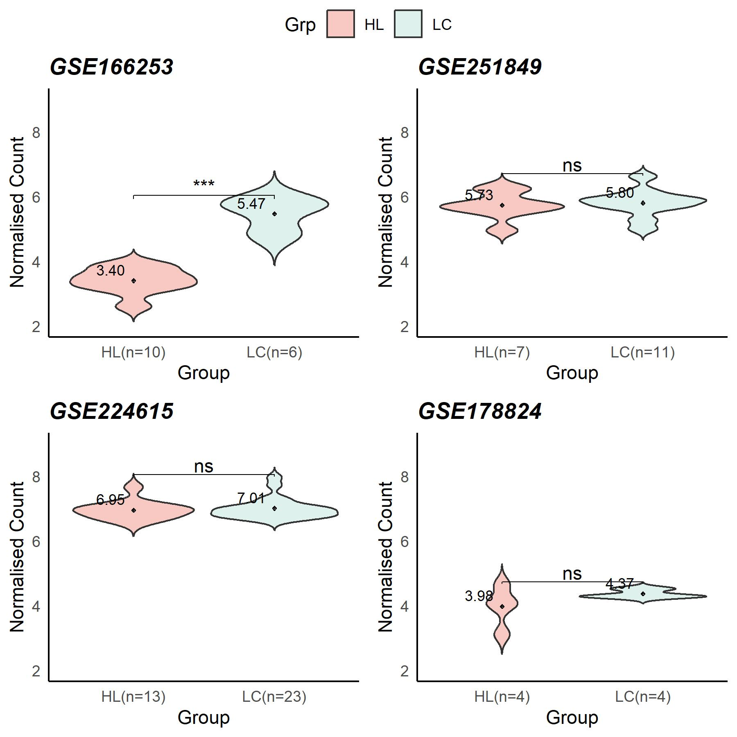
Supp Fig 3: Boxplot showing the FOXP4 expression in LC as compared to HC

Slide 4
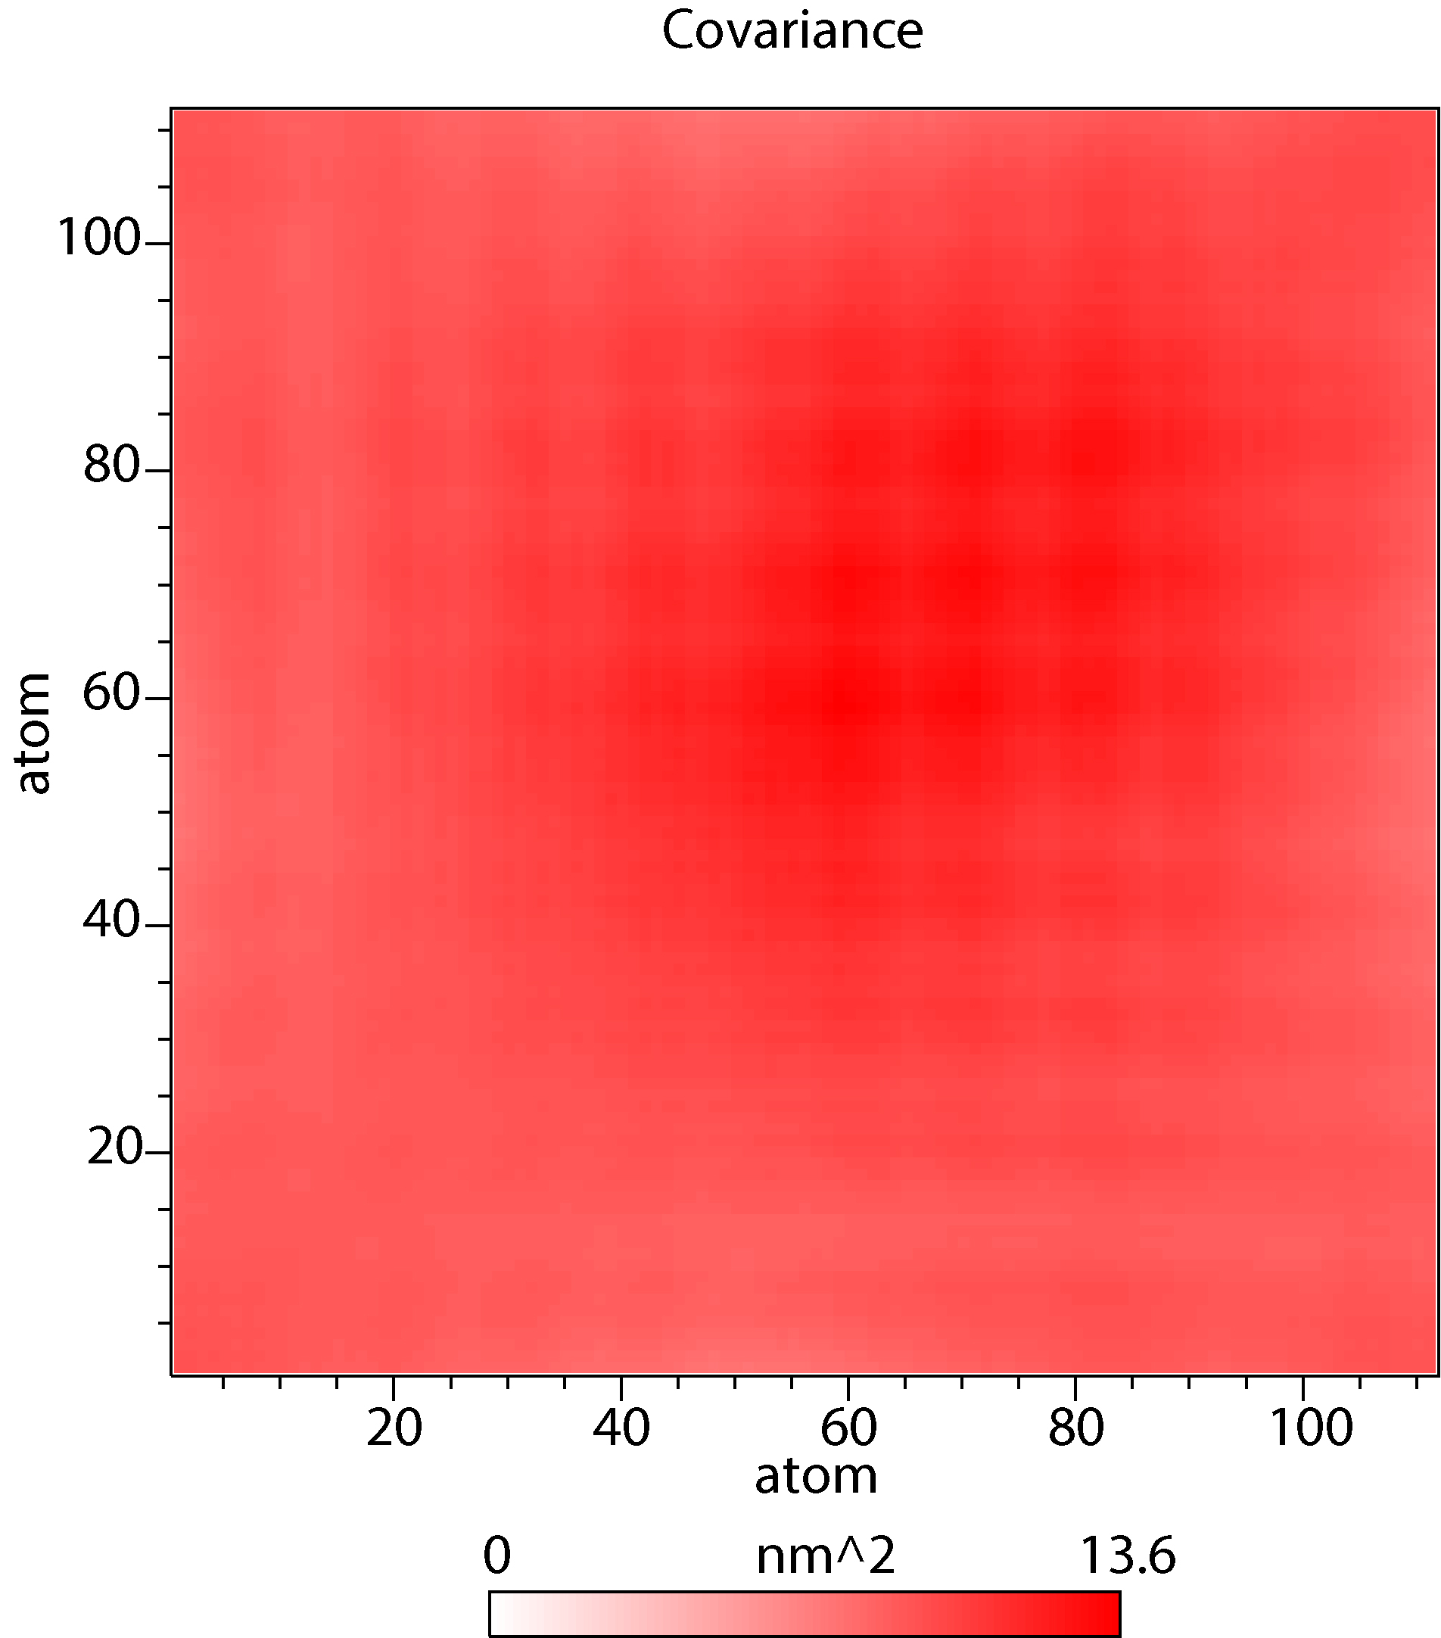
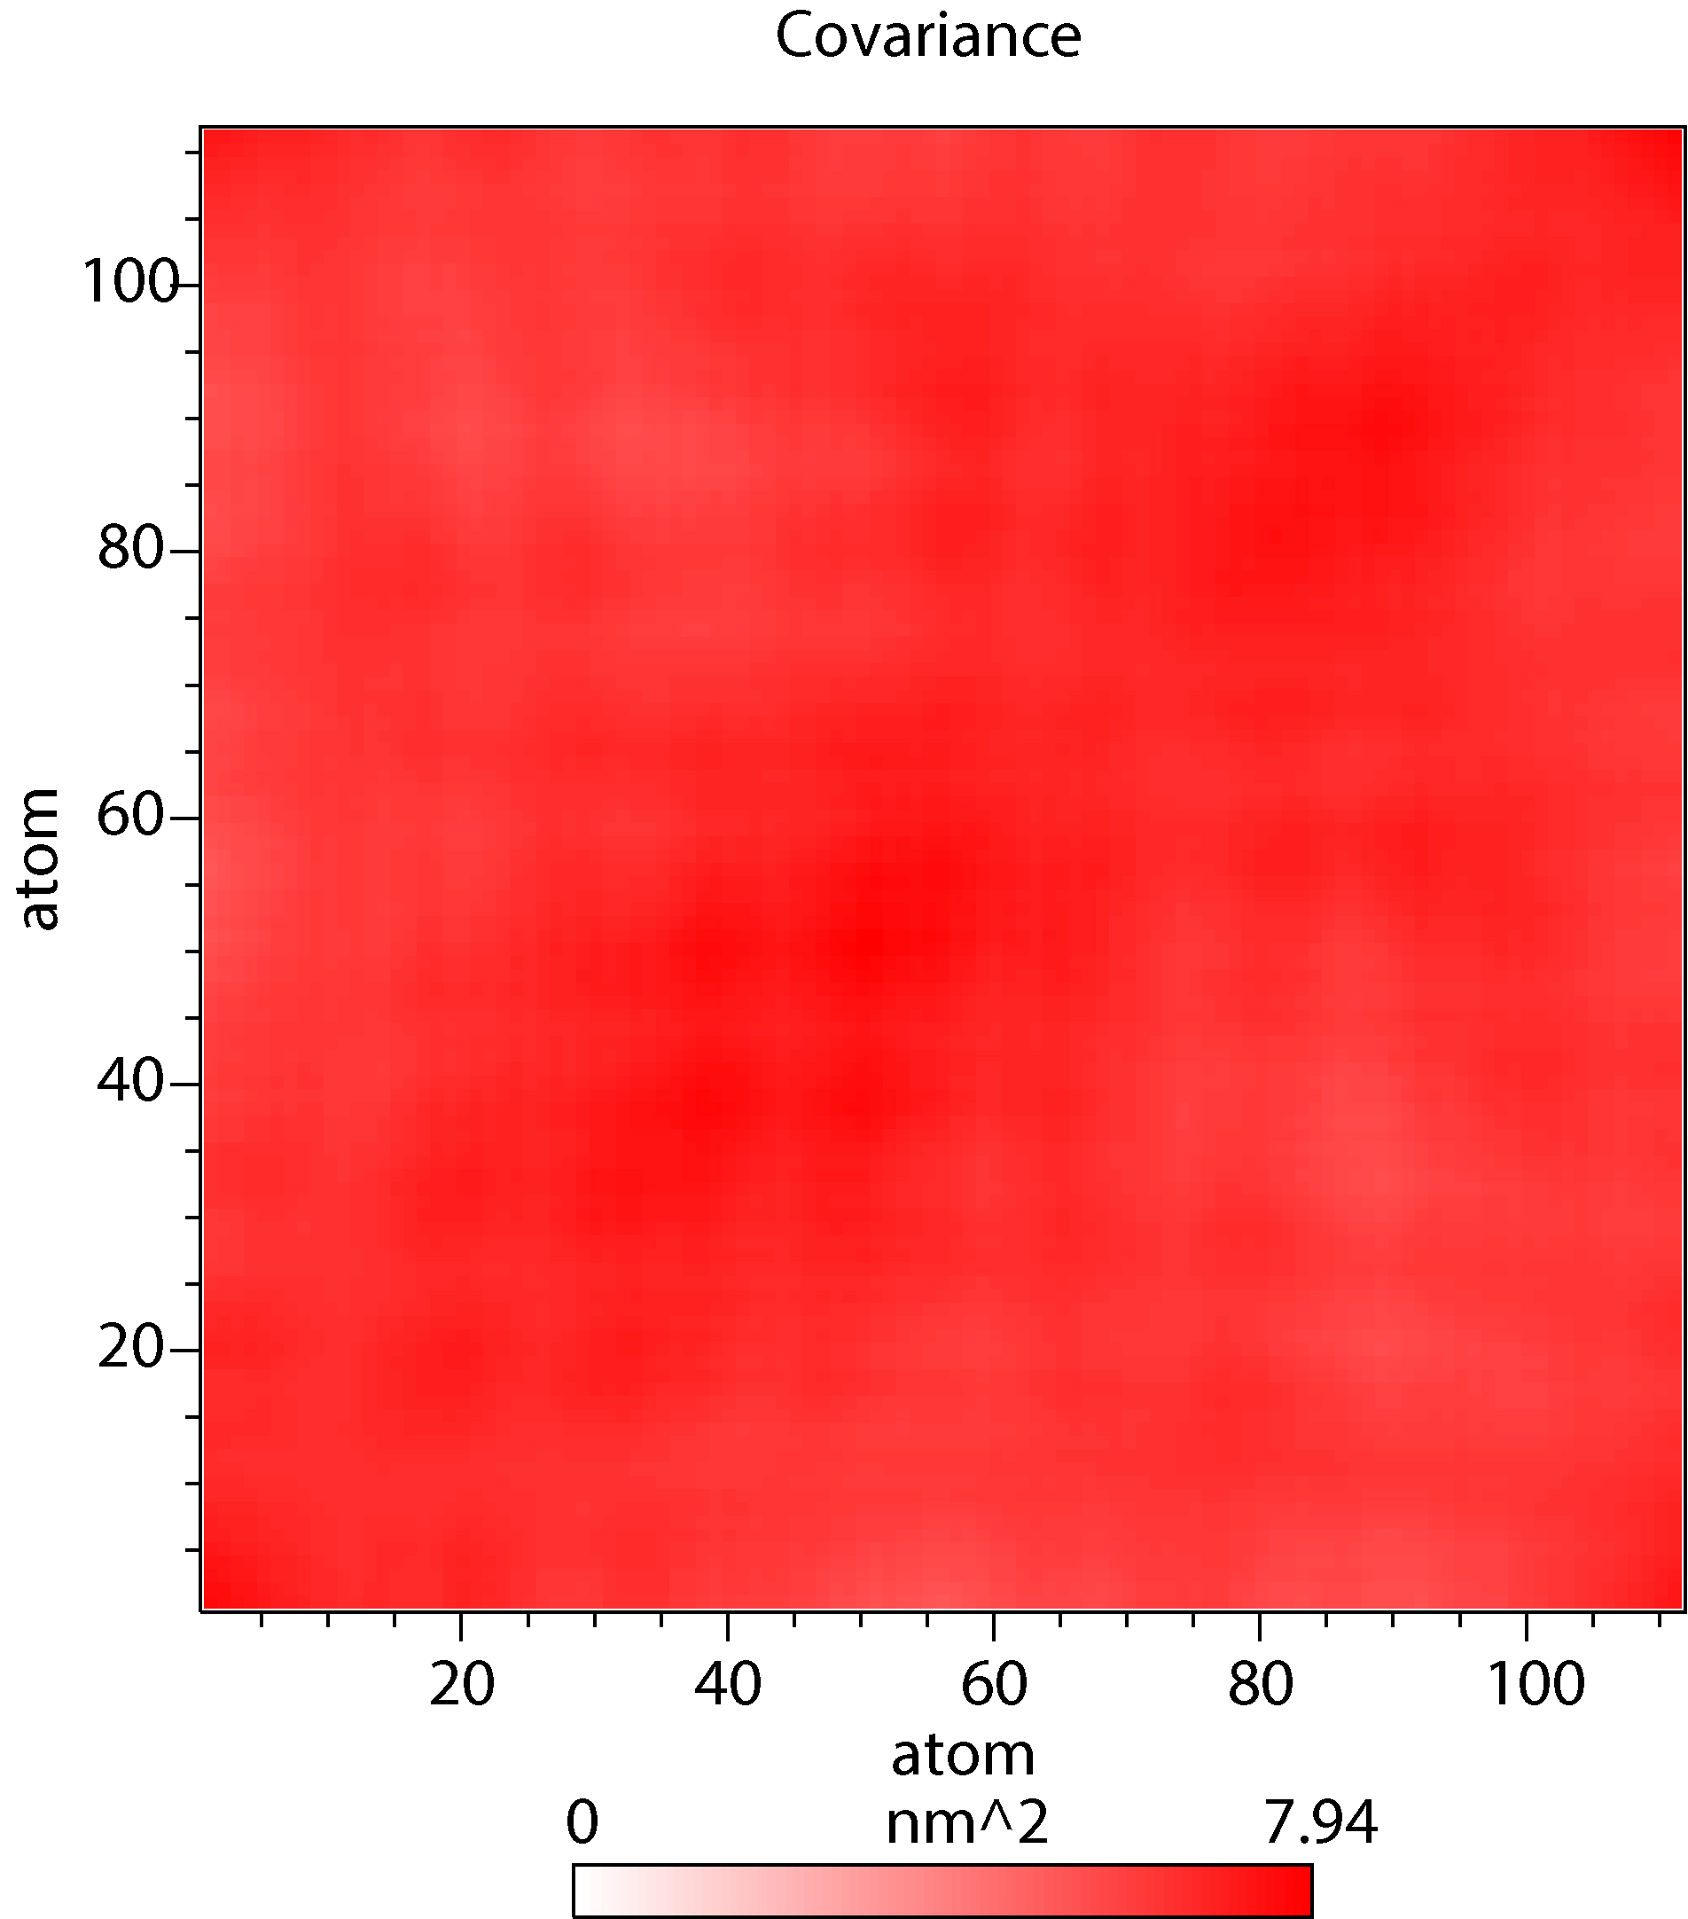
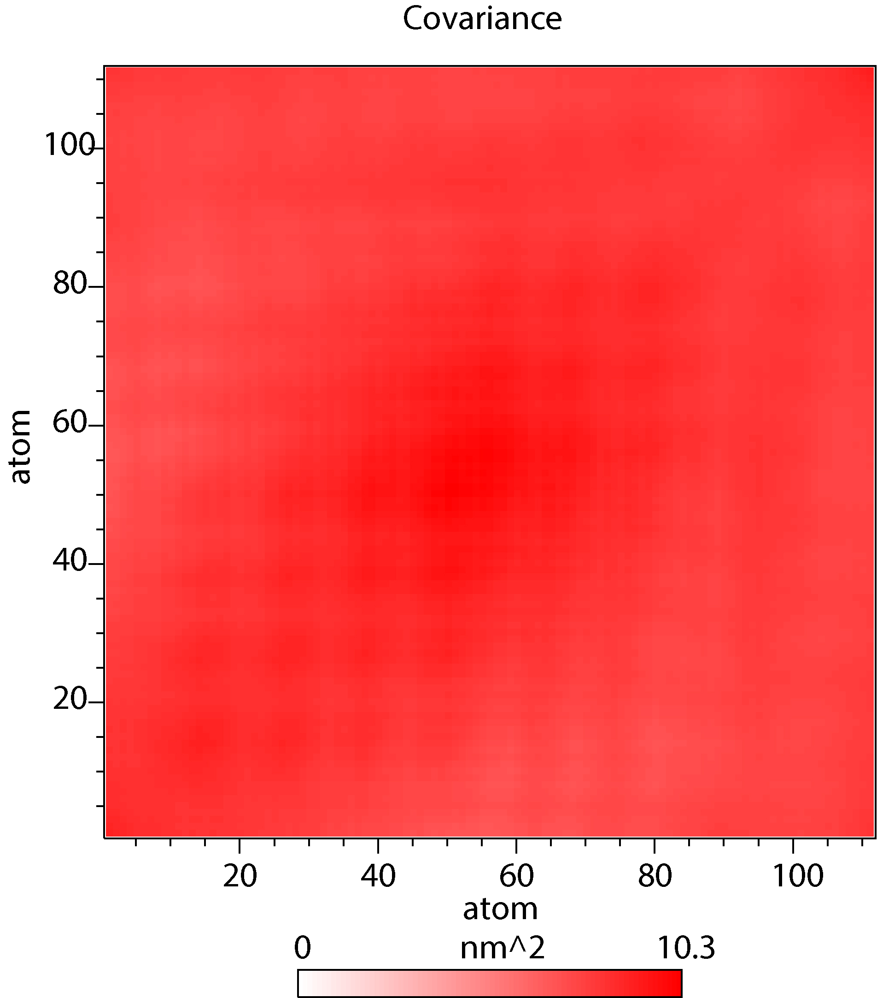
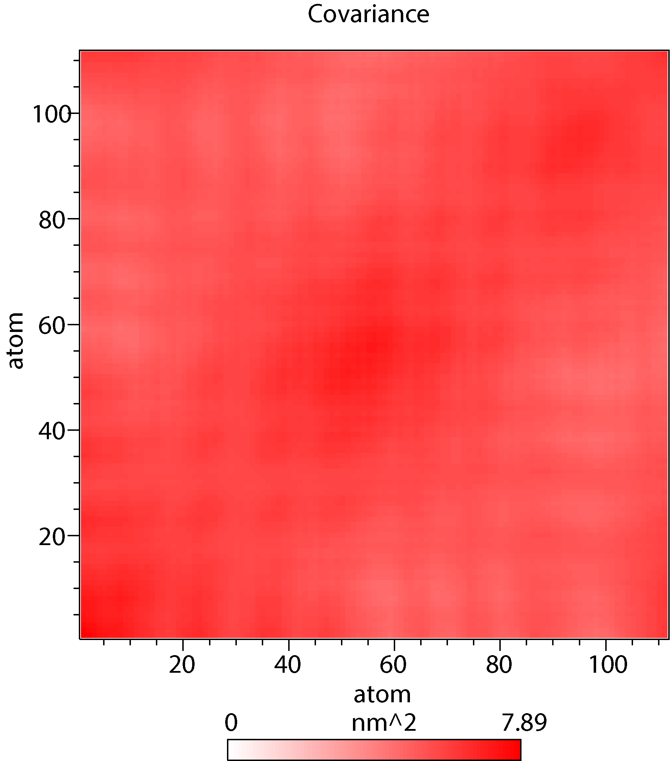
a
b
c
d
Supp Fig 4: Projections of the free energy landscape for (a) FH domain, (b) Complex I, (c) Complex II, (d) Complex III over a 400 nanosecond MD simulation are presented. Various colors within the panel denote distinct ranges of motion, with dark black indicating the lowest energy configuration and white representing the highest energy configuration.

Slide 5
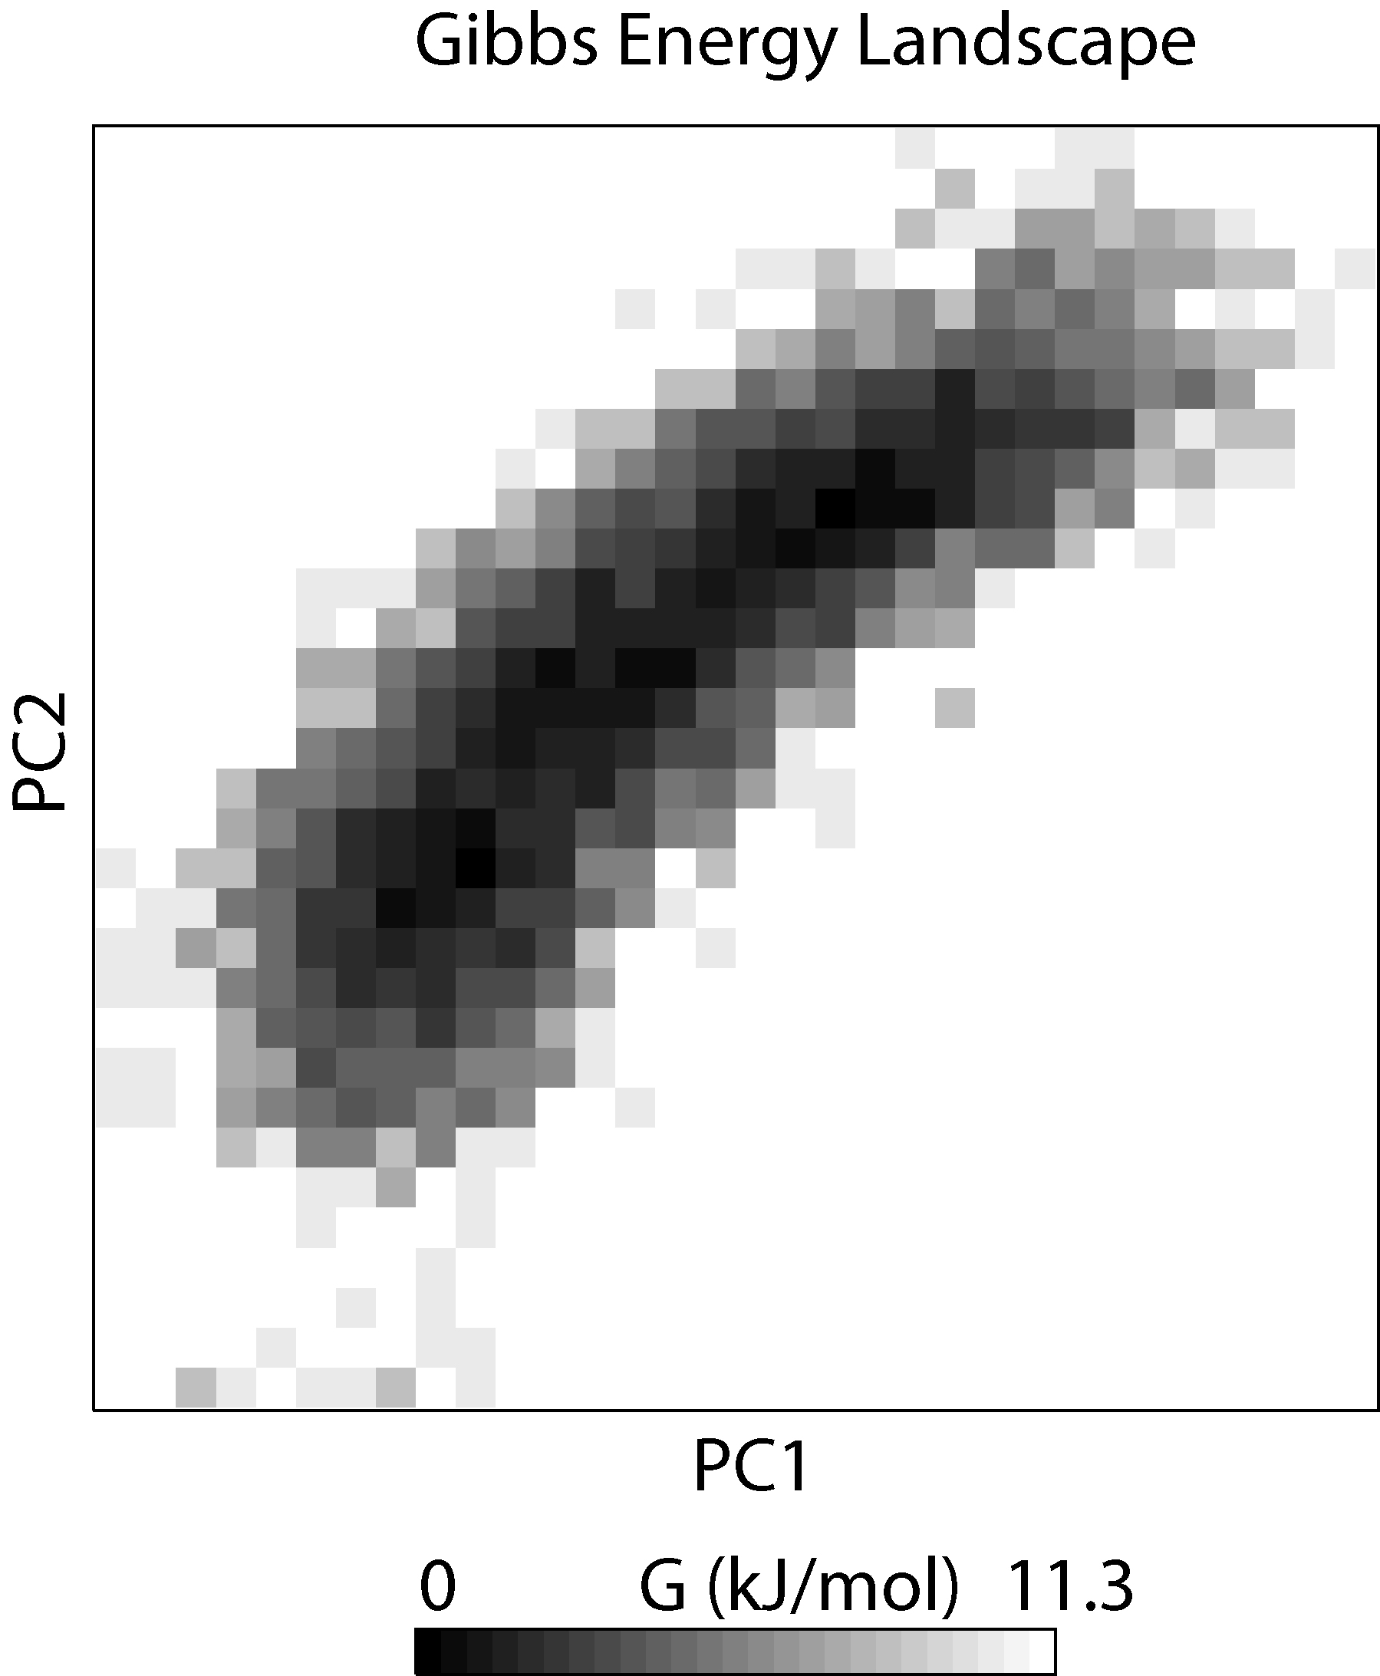
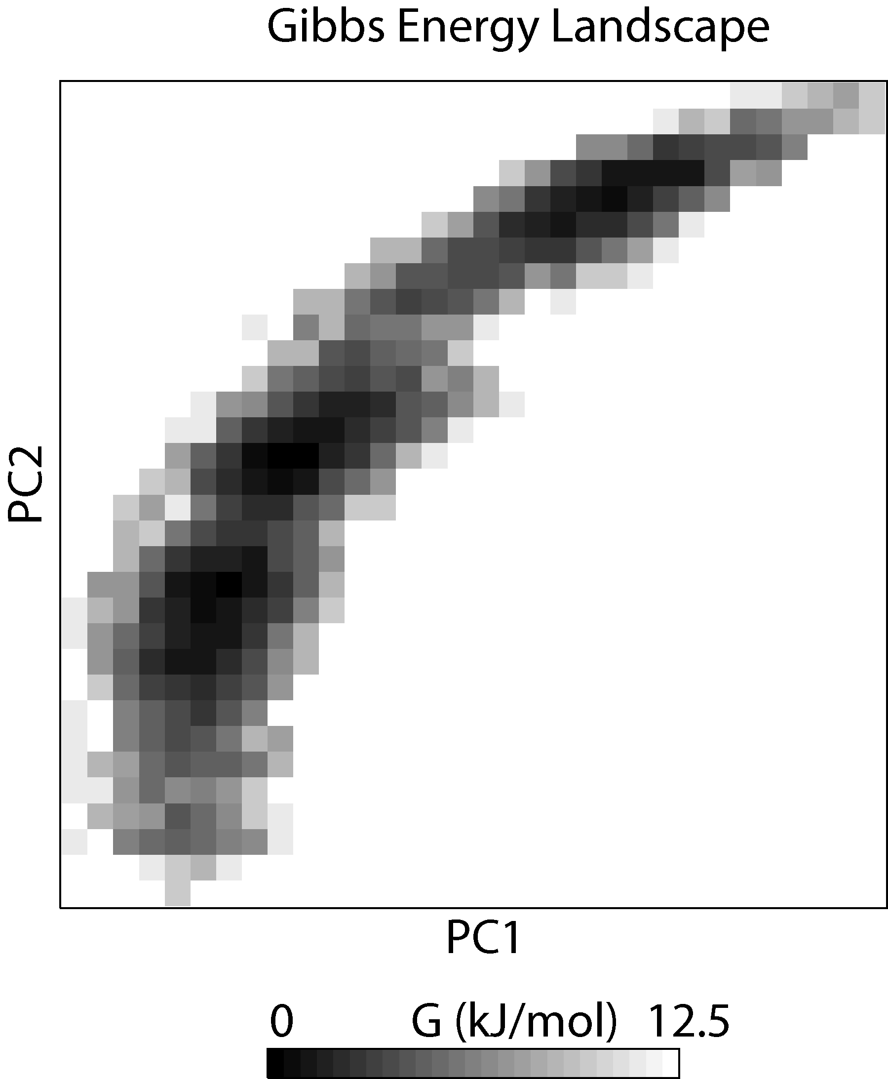
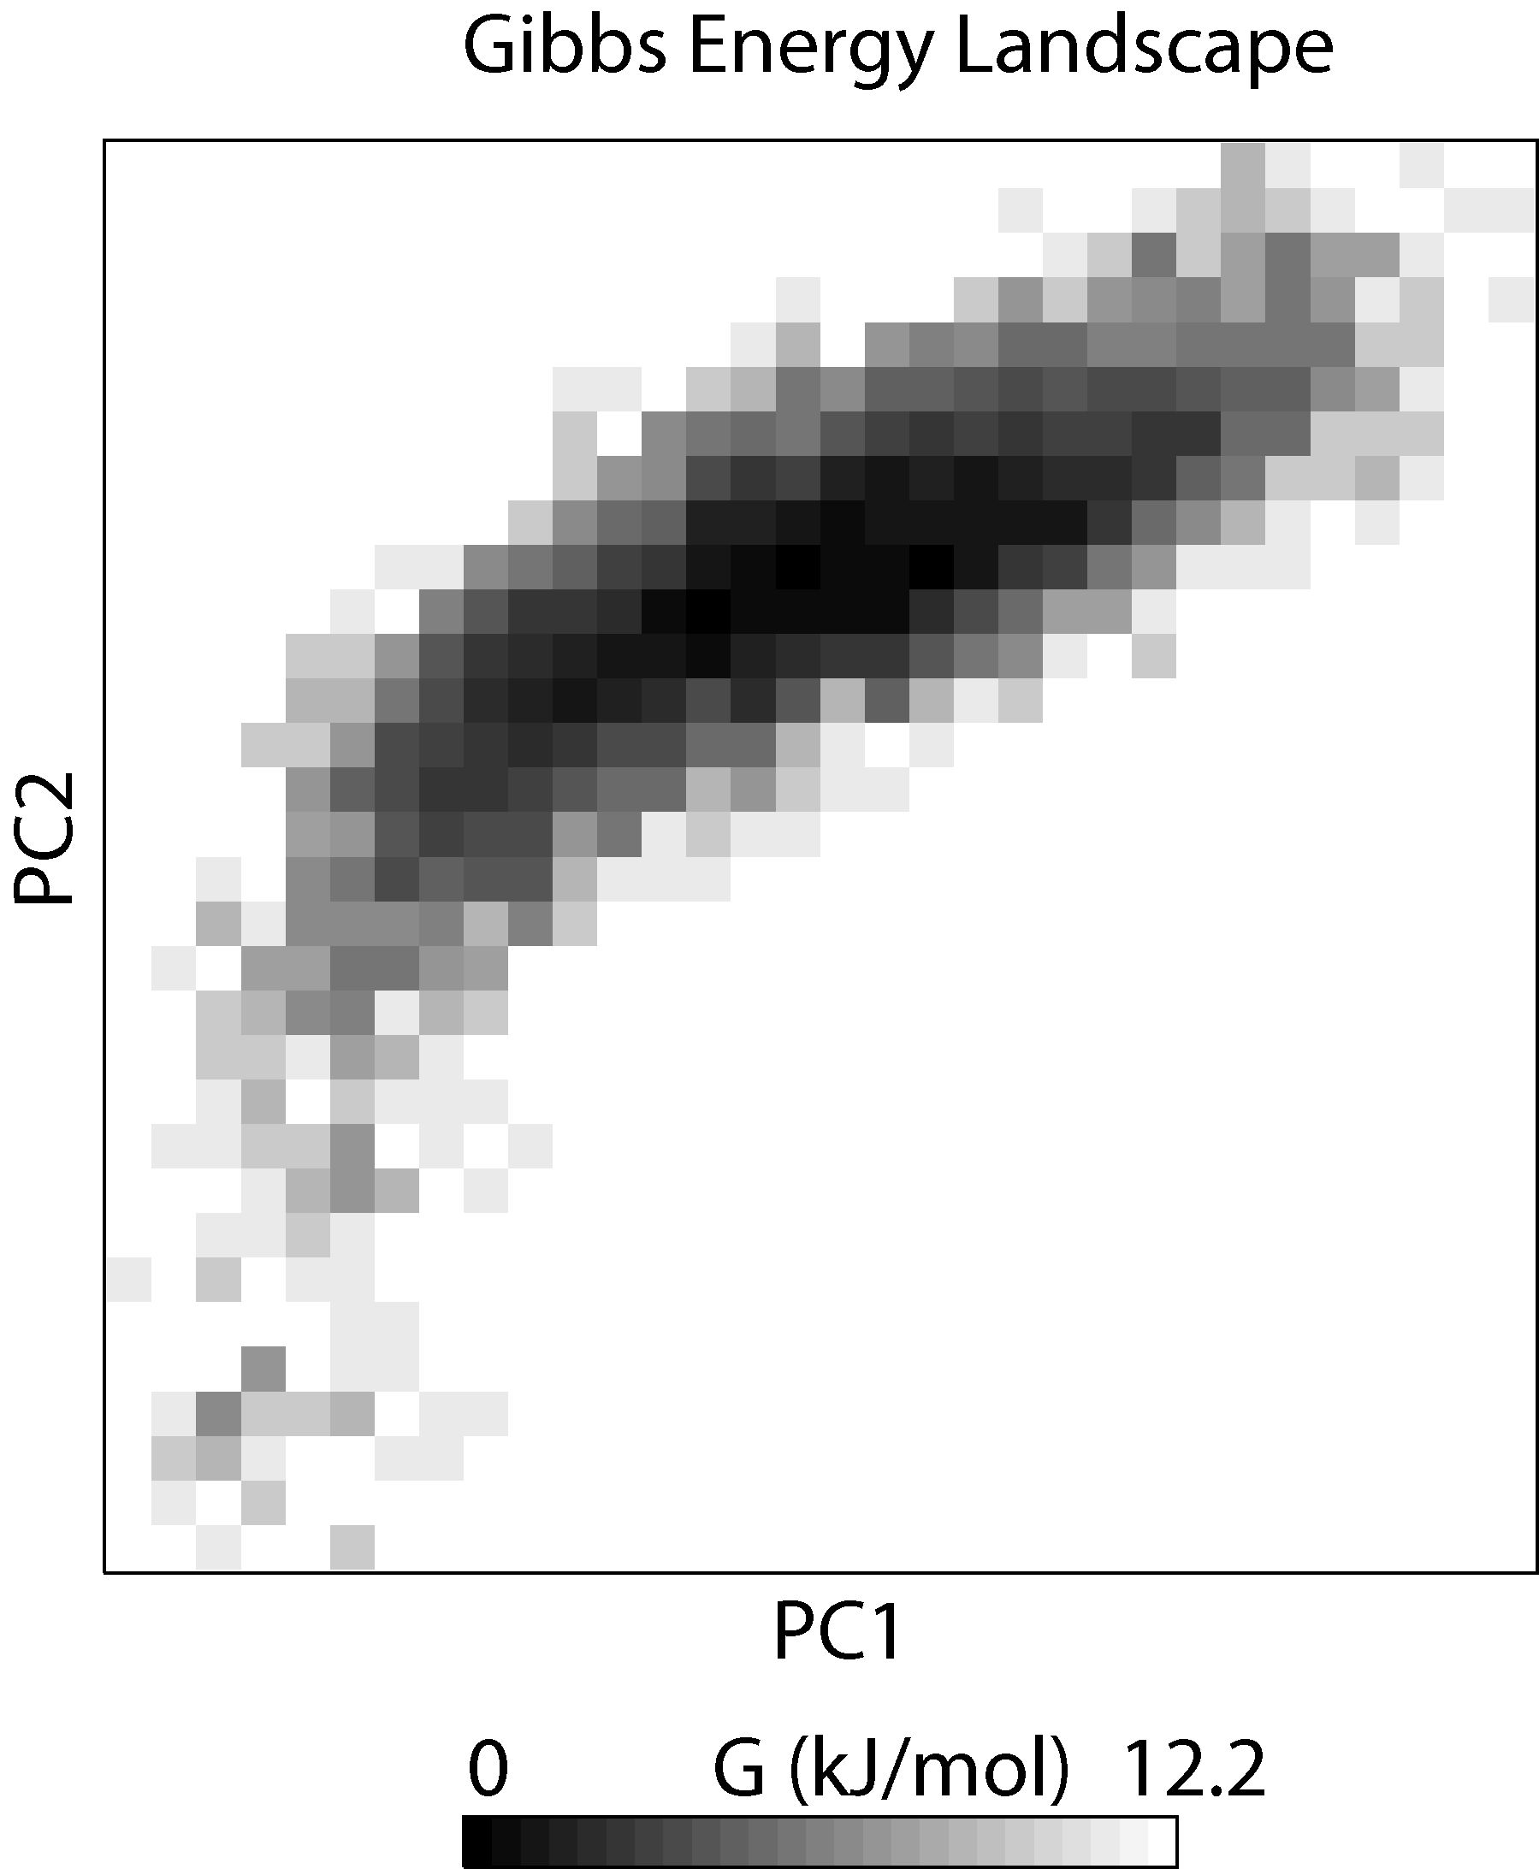
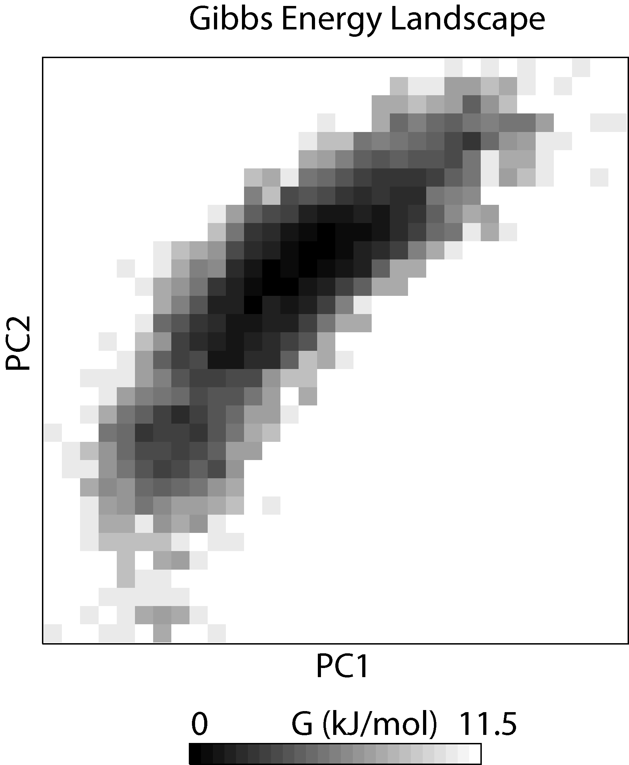
a
b
c
d
Supp Fig 5: Projections of the free energy landscape for (a) FH domain, (b) Complex I, (c) Complex II, (d) Complex III over a 400 nanosecond MD simulation are presented. Various colors within the panel denote distinct ranges of motion, with dark black indicating the lowest energy configuration and white representing the highest energy configuration.

